Slide 1
Seminar 6: Discussion
Team B
Sathira Padukka, Babatunde Ahmed, Yin Ping Lai

Slide 2
Team 2: It is our belief that the future of the Internet is based on peer-to-peer overlay-based networking (BitTorrent, TOR, Freenet, KAD).

Slide 3
Peer-to-peer Overlay-based networking
Peer-to-peer network: Infrastructure that allows two or more computer systems to connect and share resources without requiring a separate server or server software (Naomi J. Alpern, Robert J. Shimonski, 2010.)
Applications: BitTorrent, Napster, and Tor browser
Overlay-based networking: Communication networks that are built on top of another network and is supported by its infrastructure.
Peer-to-peer overlay-based network - A peer-to-peer overlay network is an ahead of client-server systems by having symmetry in roles where a client may also be a server. It allows access to its resources by other systems and supports resource sharing, which requires fault-tolerance, self-organization and massive scalability properties (Keong Lua et al., 2004).

Slide 4
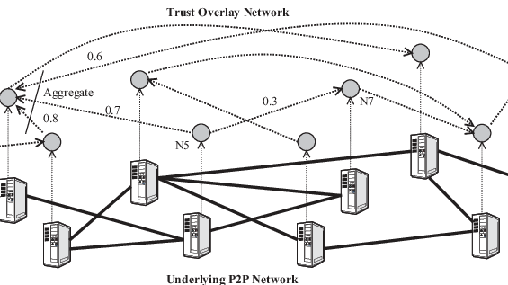
Peer-to-peer Overlay-based networking visualization

Slide 5
Why choose Peer-to-peer Overlay-based networks
one of the architectures capable of providing,
Robust
Scalable
Self-organizing
Better load balancing capabilities
Performance
No single-point of failure
Censorship resistance
networking solutions

Slide 6
Future of P2P
Blockchain technology leverages the power of P2P networks for transactions.
As a distributed ledger technology, blockchain records transactions as an immutable timestamped digital block that indicates senders and receivers.
No centralized authority manages the blockchain networks and only the participants can validate transactions among each other.
We believe there is a big market in the crypto currency and NFT space where P2P networks are used.

Slide 7
References
[1] Naomi J. Alpern, Robert J. Shimonski, (2010.), "Peer to Peer Networks". [online] Available at: https://www.sciencedirect.com/topics/computer-science/peer-to-peer-networks. [Accessed on 20 May 2022].
[2] Keong Lua, E., Crowcroft, J., Pias, M., Sharma, R. and Lim, S. (2004). A Survey and Comparison of Peer-to-Peer Overlay Network Schemes. [online] IEEE COMMUNICATIONS SURVEY AND TUTORIAL. Available at: https://snap.stanford.edu/class/cs224w-readings/lua04p2p.pdf.

